Slide 1

Emporium
One Marketplace for All
Arpit Jain (002771928)
Rebecca Biju (002768633)
Swarag Gutte (002728422)

Slide 2
Problem Statement
Boston being a student hub, has thousands of students fly in every year and hunt for second-hand goods to set up their accommodation.
There is no proper marketplace that facilitates the entire process and most people leave unwanted items on the footpath. This could get infested with bedbugs and other insects.
Our application bridges this gap by letting suppliers sell and donate items to NGOs, who in turn can help the needy.

Slide 3





KEY FEATURES
Email Notification
Password Encryption
Live Photo Capture
Data Analysis Charts
File Export

Slide 4
Approach
A system to handle selling of second hand items.
The four main Enterprises are Supplier, Consumer, Logistic and Supervision
Supplier provides items which can be collected by Consumers
The system operates within networks (Cities). So the consumers can see suppliers who are in the same network as them and assign a logistic partner to deliver the items
The logistic enterprise is the intermediary between Suppliers and Consumers who pick up and deliver the items
The Consumers can redirect the request to other consumers facing shortage of the particular Item.
Logistics charges the requesting Consumer for the deliveries, sending them invoices which are then paid for by the Consumer Manager
A Supervision Enterprise can view all the activities within the different Enterprises in their network (Disposal of items avoided, expenses incurred, etc)

Slide 5
Use Case - Collection Request
A collection request for items is created by the supplier, which is then sent across to all the consumers within the network
A consumer manager can view all the request raised by supplier for pick-up and assign it to an employee in their enterprise, who will then proceed with the collection of the delivery and updating the inventory
If the Consumer manager feels they have sufficient items in the inventory and sees a shortage request from other Consumer, they can directly assign it to the Consumer for further processing
The request is then forwarded to logistics manager’s queue
Any logistics manager can pickup the request and assign it to one of their employee
The said employee then picks up the package from the requested supplier and delivers it to the Consumer
A delivery cost is assigned on delivery completion.
The Consumer worker collecting this request then updates the enterprises’ inventory with the item delivered

Slide 6
Use Case - Invoice Request
After a successful delivery, a delivery cost is provided against it
A Logistics manager can then generate an invoice for all successful deliveries made by their enterprise, to a particular Consumer
This request is then forwarded to the respective Consumer’s manager who would then be responsible for the payment of the same

Slide 7
Use Case - Item distribution
Any Consumer worker can distribute items to people from the collection.
The employee can view the inventory, as well as the time before which the particular item would be disposed off
The number of people served are then updated after a particular distribution

Slide 8
Use Case - Shortage Request
A Consumer manager can raise a shortage request
The manager also mentions an employee who would then follow-up on the request
This request is then forwarded to all other Consumer managers within the network
A Consumer manager can then redirect a particular collection request to an NGO facing a shortage
The logistics and collection then proceeds like a usual collection request
This collection request is linked to the original shortage request.

Slide 9
Use Case - Supervision
A Supervisor (Mayor) can view the interactions between the various enterprises within their network
Mayor can also check the expenses incurred by the Consumers in helping avoid wastages.

Slide 10
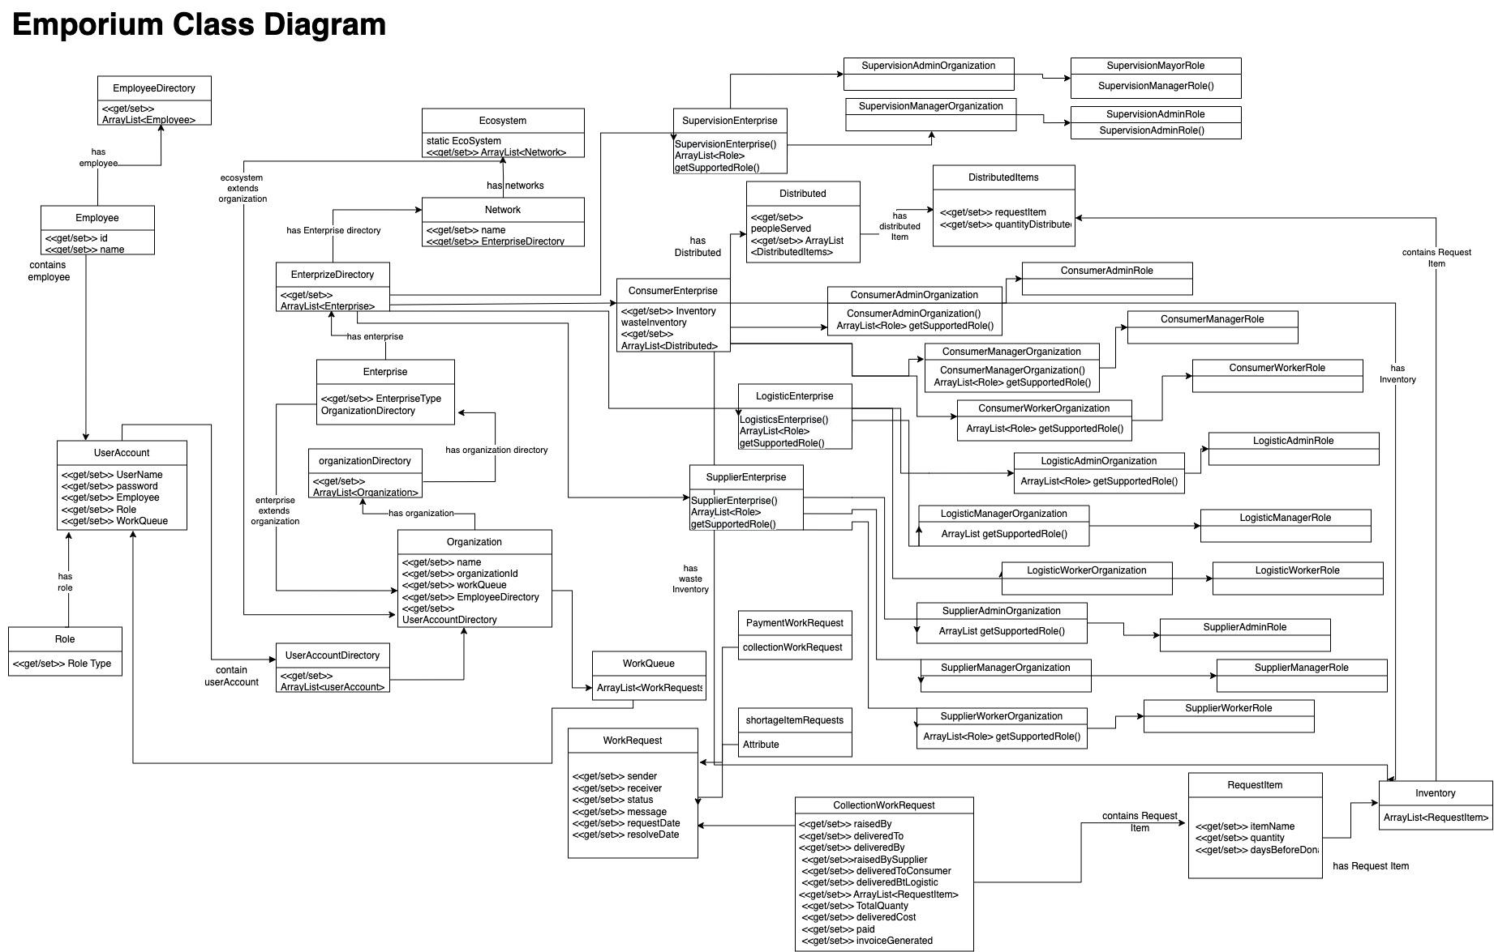
Class Diagram

Slide 11
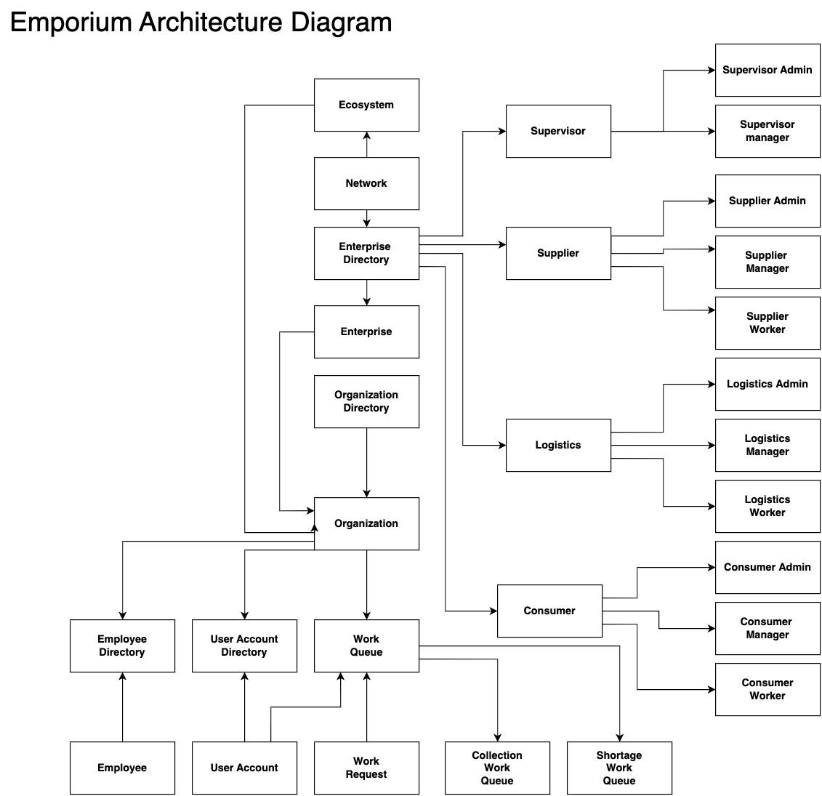
Architecture Diagram

Slide 12

IN THE FUTURE
Enable Capture of Photos when Items are delivered.
Live Tracking of shipment using sockets

Slide 13
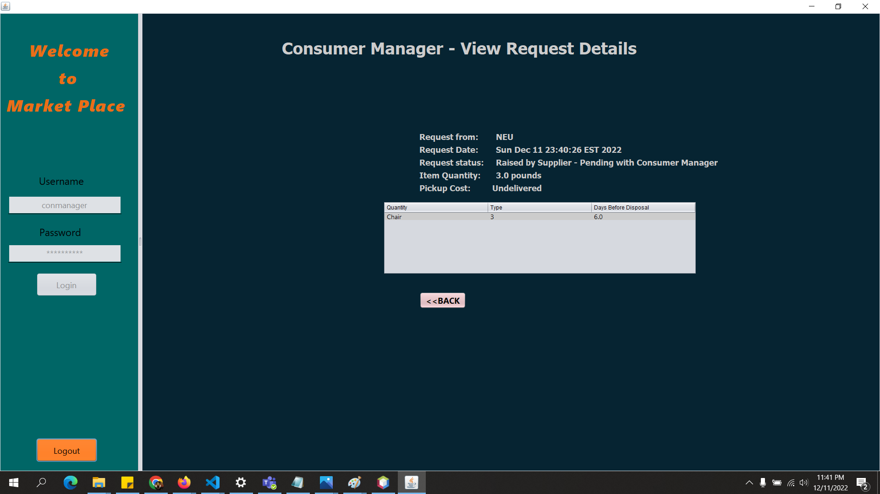

Slide 14
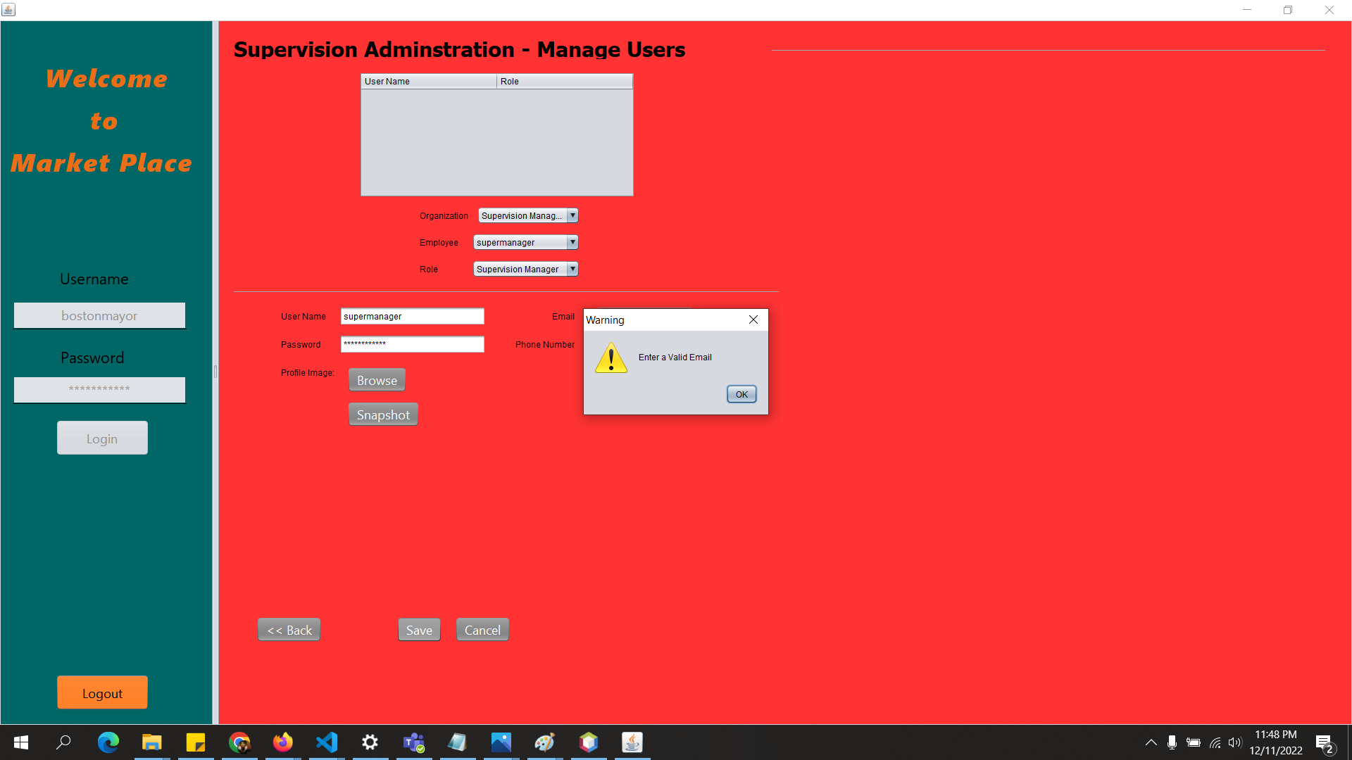

Slide 15
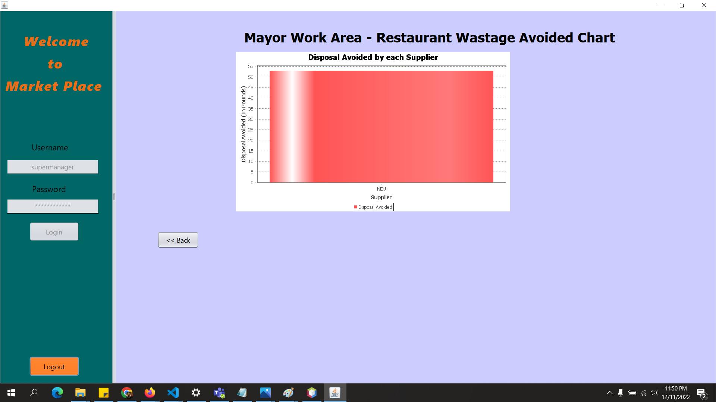

Slide 16
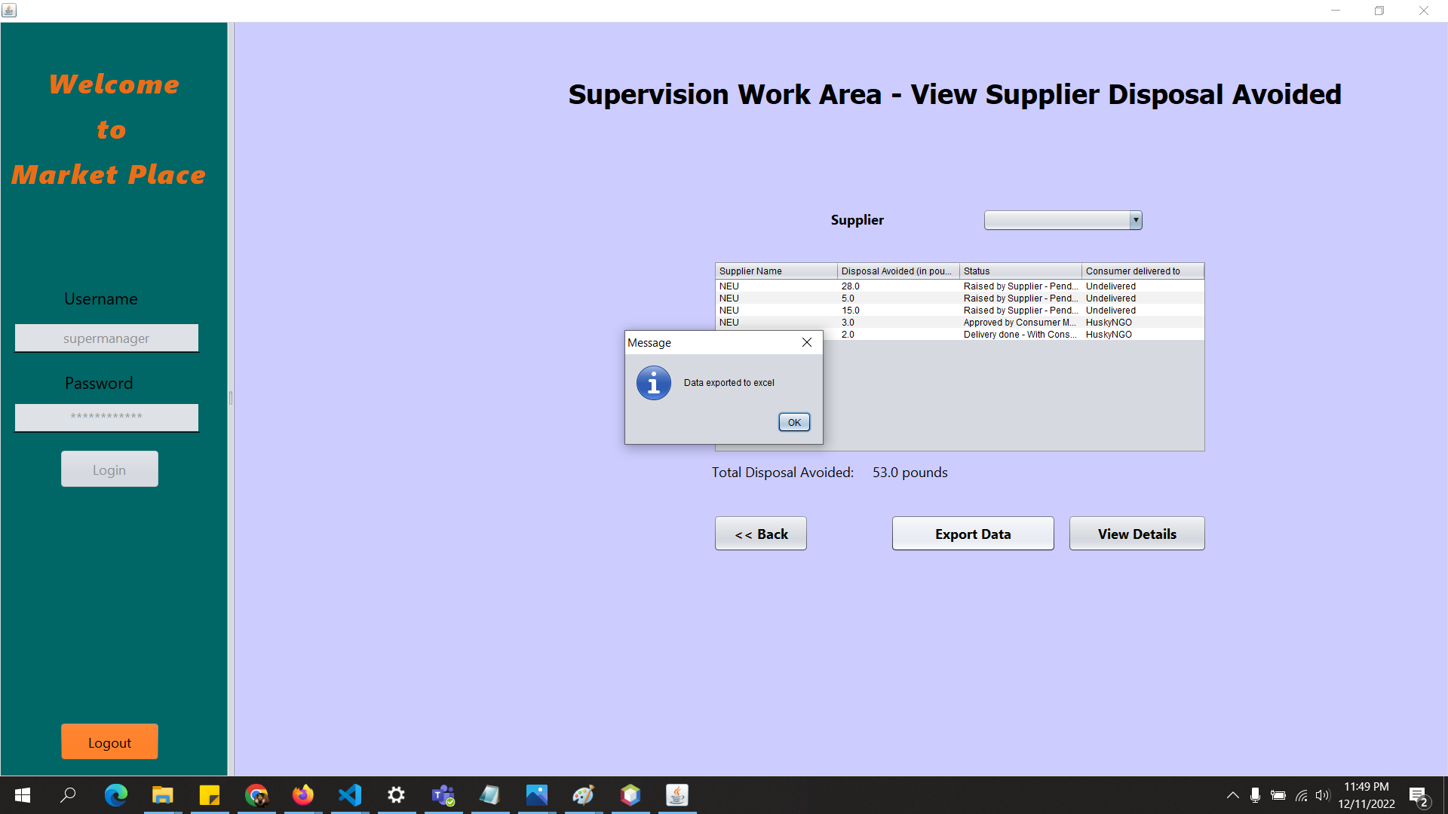

Slide 17
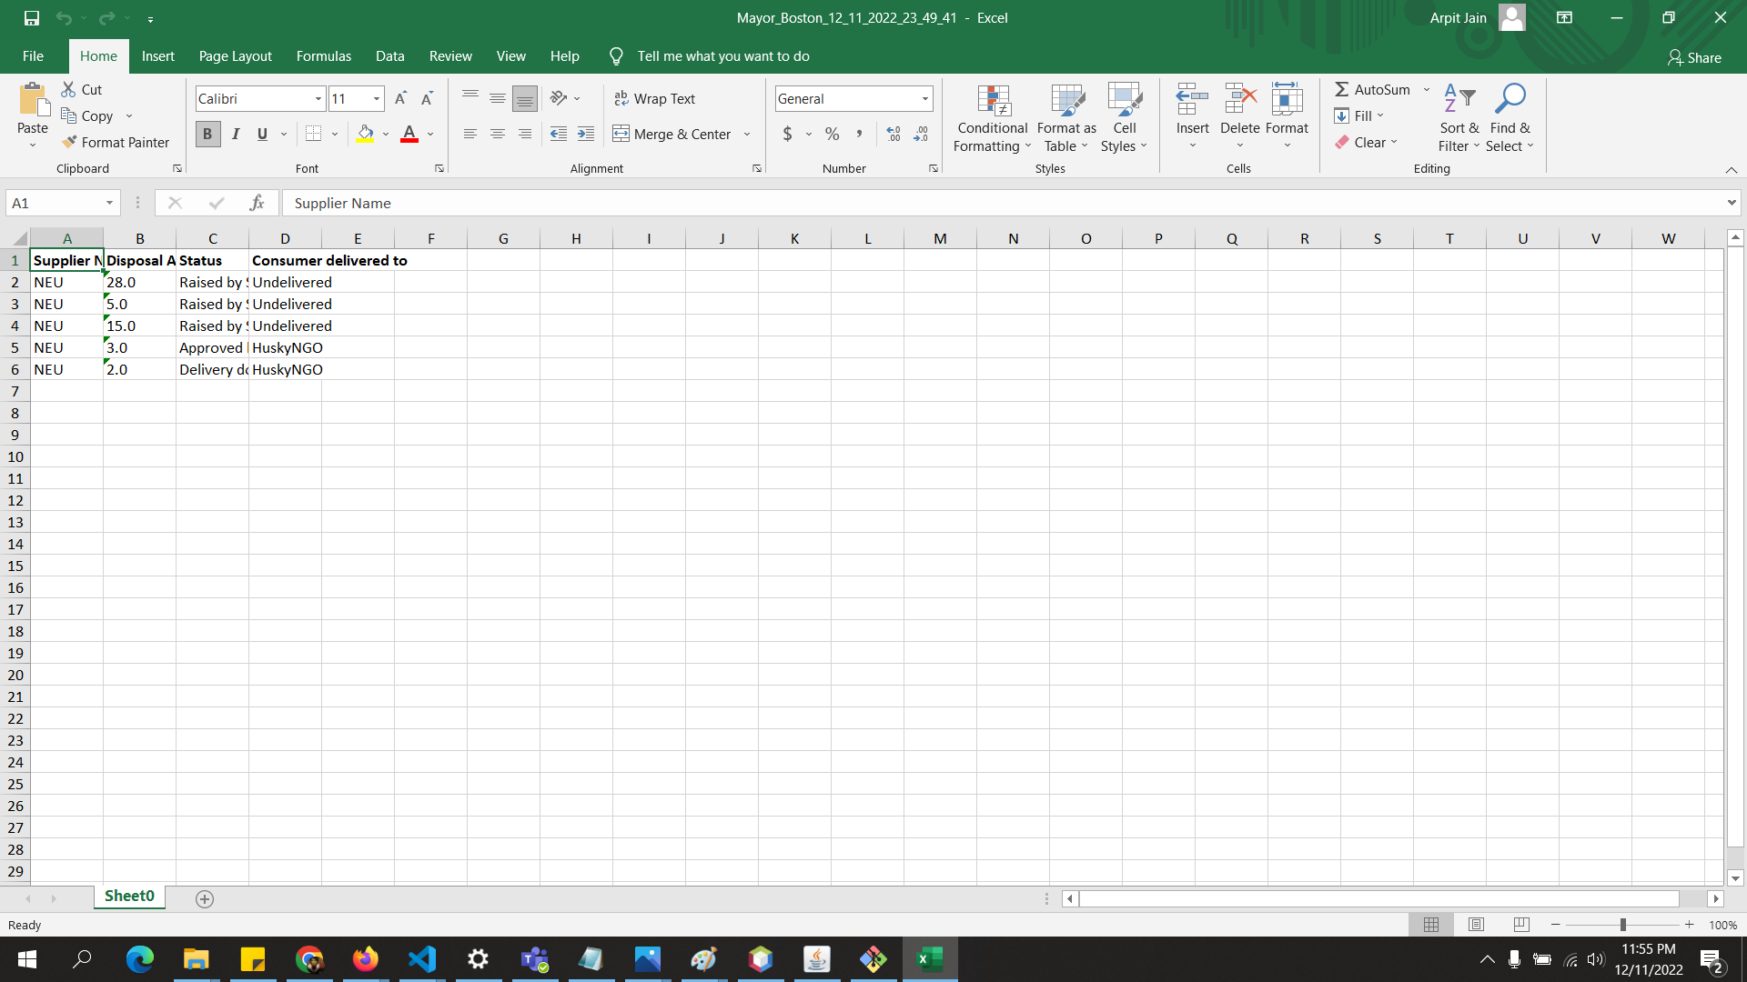

Slide 18
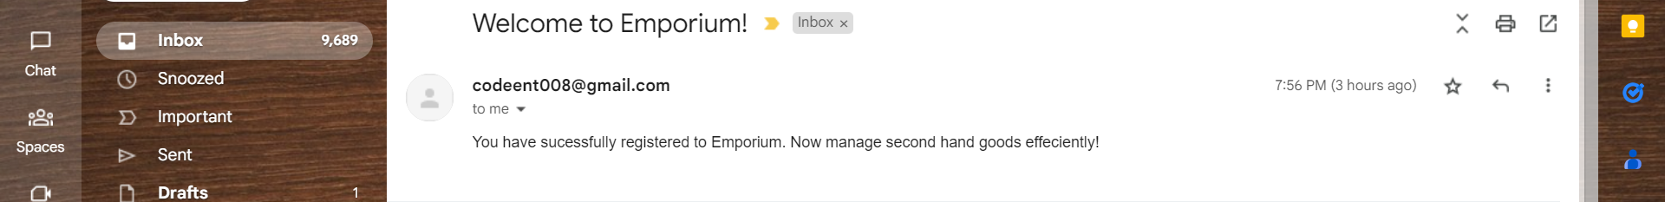
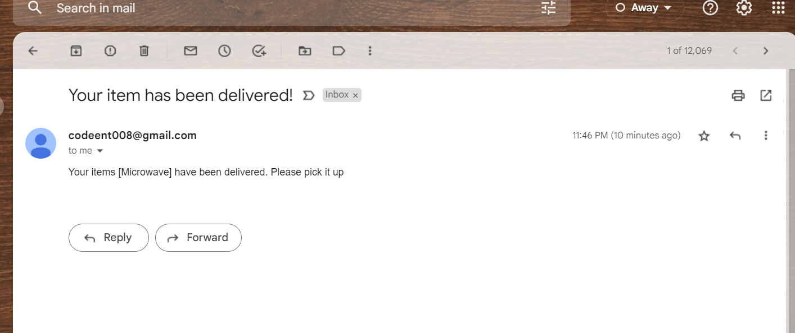

Slide 19

Thank You!

